Slide 1
Exploratory Analysis of World Suicide Statistics
By Blake List, Nina Sun, Jaibir Batth and Shun Li

Slide 2
Background & Datasets
Suicide Rates per 100,000 population (1950 - 2016) - World Health Organization
Social support, Life expectancy & GDP (2010 - 2016) - Happiness Report
Public Health Funding per country (2016) - Scraped from Wikipedia

Slide 3
Questions
How do suicide rates differ by gender per 100,000 population?
How are happiness report variables like social support related to suicide rates?
How is public health spending per country related to suicide statistics?

Slide 4
Methods & Tools
Combining relational datasets on intersecting variables and rows.
Gathering and spreading dataframes for plotting.
Scraping data from webpages.
R Packages
tidyverse
ggplot & ggmap
gganimate & transformr
rvest
Julia Packages
DataFrames
DataFramesMeta
VegaLite

Slide 5
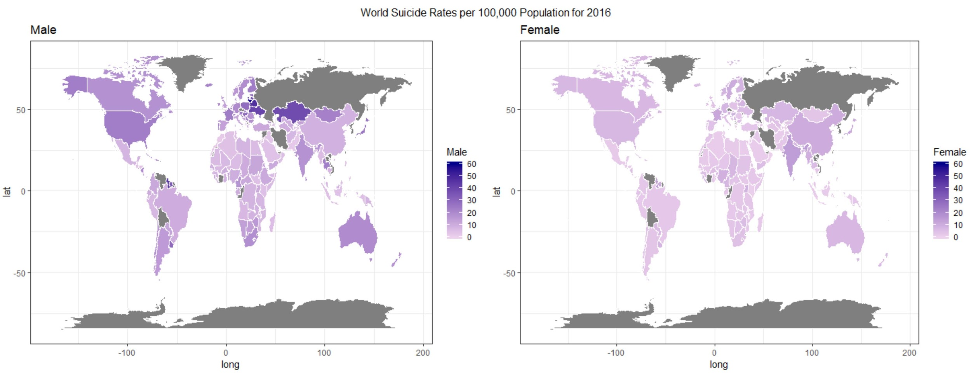
Results: World Suicide Rates by gender for 2016

Slide 6
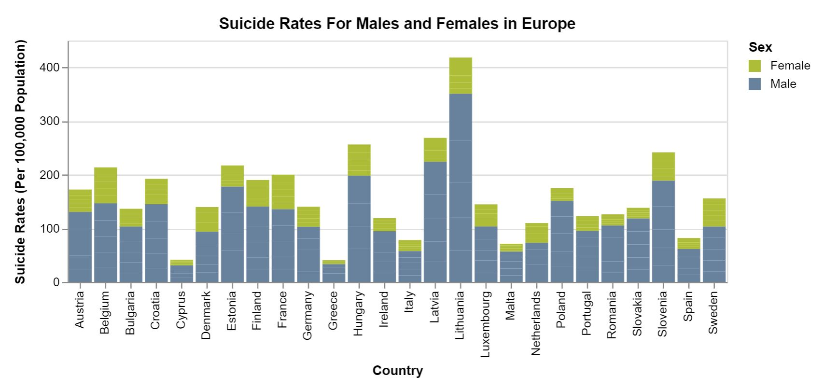
Results: Suicide rates by gender in Europe for 2016

Slide 7
Results

Slide 8
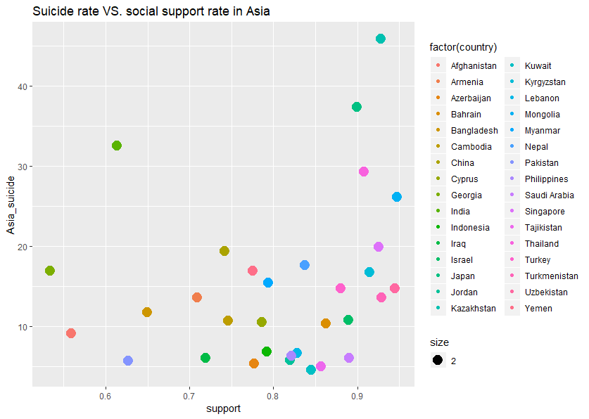
Results: Suicide rate and social support in Asia for 2016

Slide 9
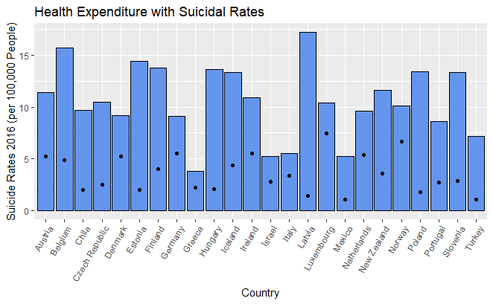
Results: Suicide rate and health expenditure for 2016

Slide 10
Discussion: Roadblocks & Future Work
Roadblocks
Datasets containing different countries or years - merging meant losing information.
Implementation of the map plot - finding a way to create map polygons in ggplot.
Animating plots - using year column data to smoothly transform between observations.
Julia - package updates and VegaLite plotting of multiple columns.
Future Work
Collect more data!
Compare suicide statistics between Eastern and Western continents.
Explore the effect of other burdening diseases and disabilities on suicide rates.

Slide 11
Summary
On average, males have higher suicide rates per 100,000 population than females.
Overall ‘happiness’ of a country does not imply lower suicide rates.
More public health/mental health funding from governments could lead to a drop in suicide statistics.
More awareness of mental health is needed!

